Slide 1

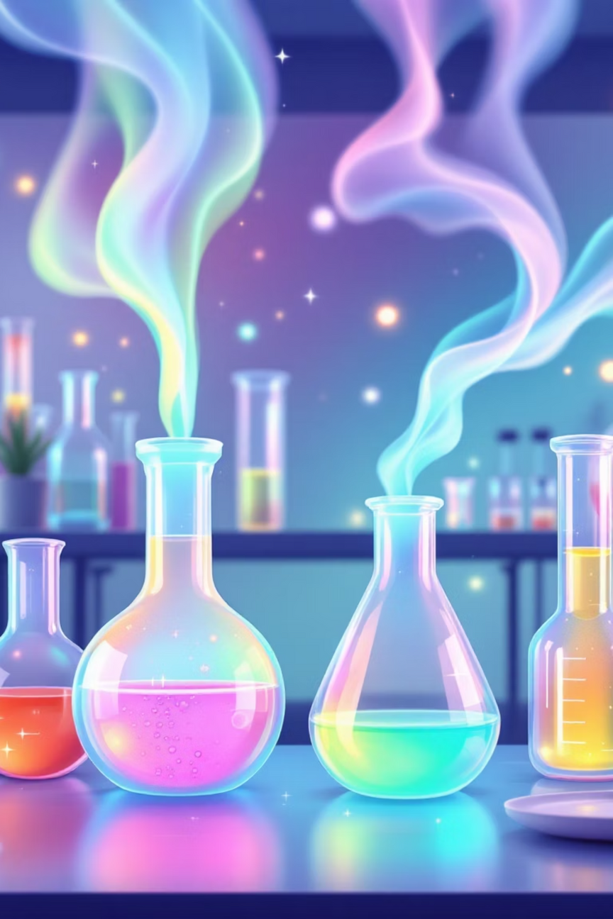
Some Basic Concepts of Chemistry
Chemistry is the science of molecules and their transformations - the study of matter, its properties, structure, and the changes it undergoes during chemical reactions.
Notes:
1

Slide 2
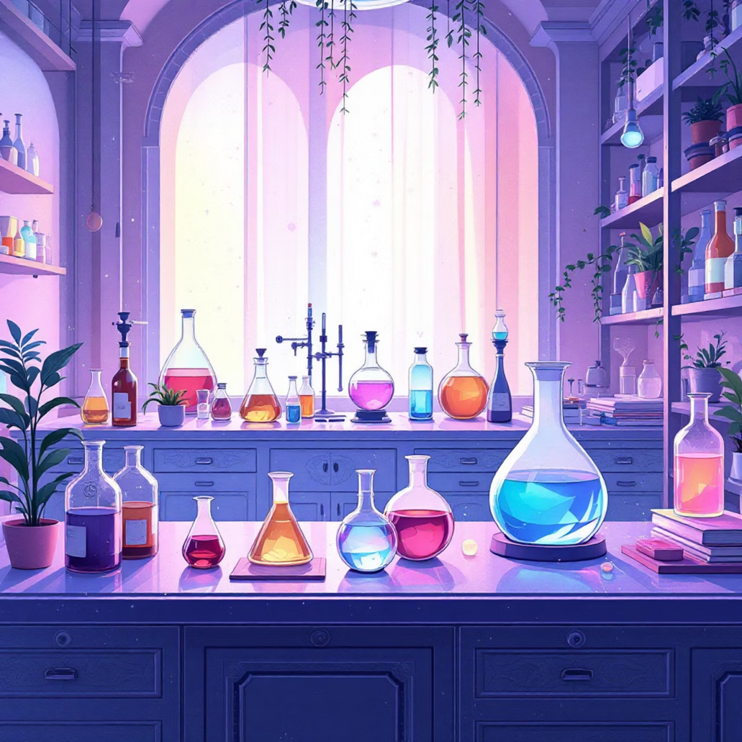
Ancient Indian Chemistry Legacy
Historical Foundations
Ancient India called chemistry Rasayan Shastra, encompassing metallurgy, medicine, and material science. Archaeological evidence from Mohenjodaro and Harappa shows advanced chemical processes including pottery, metallurgy, and glass-making dating back thousands of years.
  Copper metallurgy and iron extraction
  Glass and ceramic production
  Dyes, perfumes, and cosmetics
Notes:
2

Slide 3
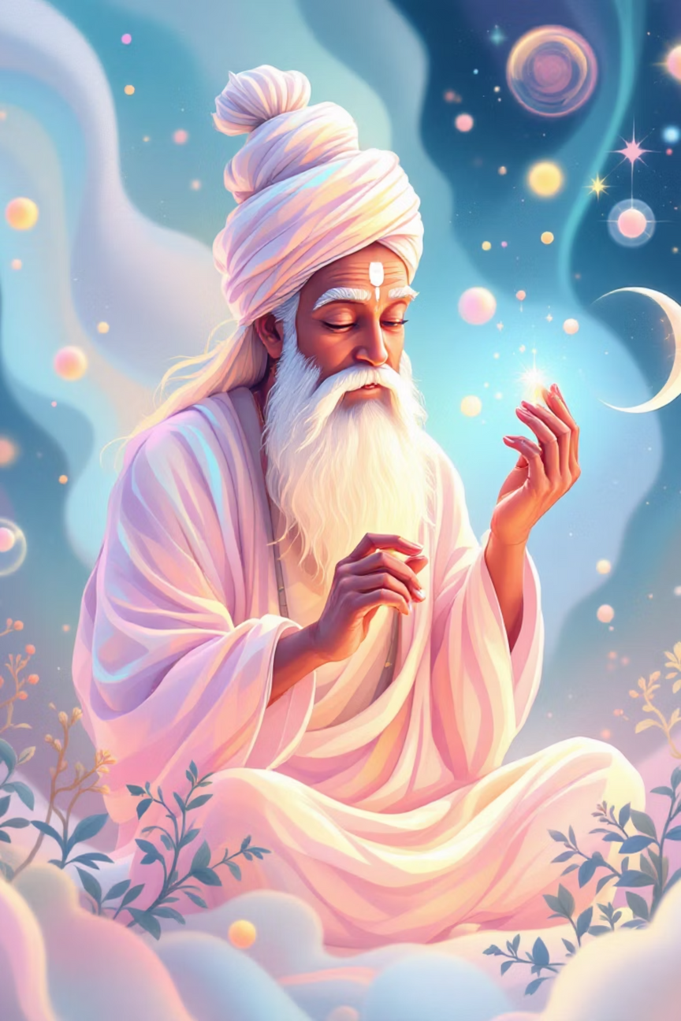
Atomic Theory Origins
1
600 BCE - Acharya Kanda
First proposed atomic theory with Paramanu (indivisible particles) - 2500 years before Dalton's atomic theory.
2
1808 - John Dalton
Modern atomic theory: matter consists of indivisible atoms with identical properties for each element.
3
Present Day
Advanced understanding of atomic structure, isotopes, and molecular behavior through modern techniques.
Notes:
3

Slide 4
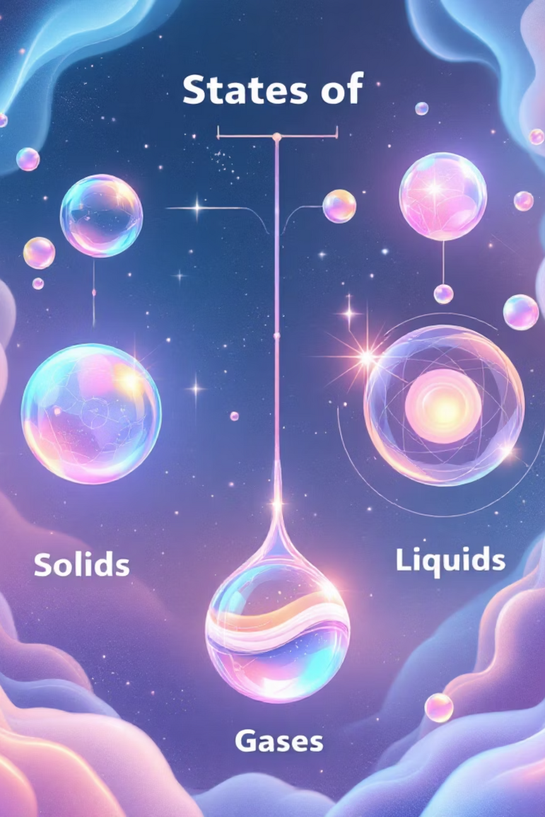

States of Matter
Solids
Liquids
Particles held close together in orderly fashion. Definite volume and shape with restricted movement.
Particles close but mobile. Definite volume but take container shape. Moderate particle movement.
Gases
Particles far apart with rapid movement. No definite volume or shape - completely fill containers.
Notes:
4

Slide 5




Classification of Matter
Mixtures
Variable composition, components separable by physical methods. Can be homogeneous (uniform) or heterogeneous (non-uniform).
Elements
Single type of atoms. Cannot be broken down by chemical methods. Examples: hydrogen, oxygen, carbon.
Compounds
Two or more elements combined in fixed ratios. Properties differ from constituent elements. Examples: water, carbon dioxide.
Notes:
5

Slide 6
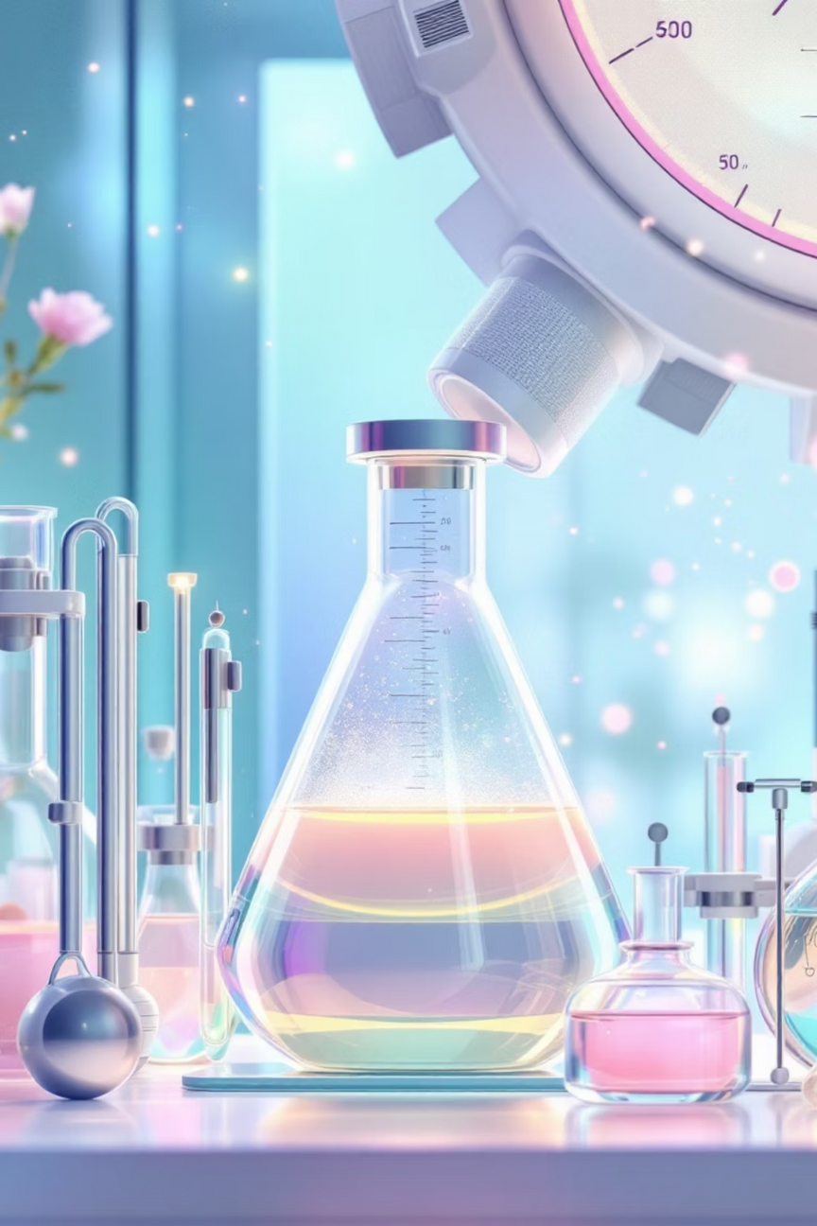




SI Units and Measurements
Length - Metre (m)
Based on speed of light in vacuum. Laboratory uses cm, mm for smaller measurements.
Mass - Kilogram (kg)
Defined by Planck constant. Chemistry uses grams for practical measurements.
Time - Second (s)
Based on caesium frequency. Universal standard for all time measurements.
Temperature - Kelvin (K)
Absolute temperature scale. Related to Celsius: K = °C + 273.15
Notes:
6

Slide 7
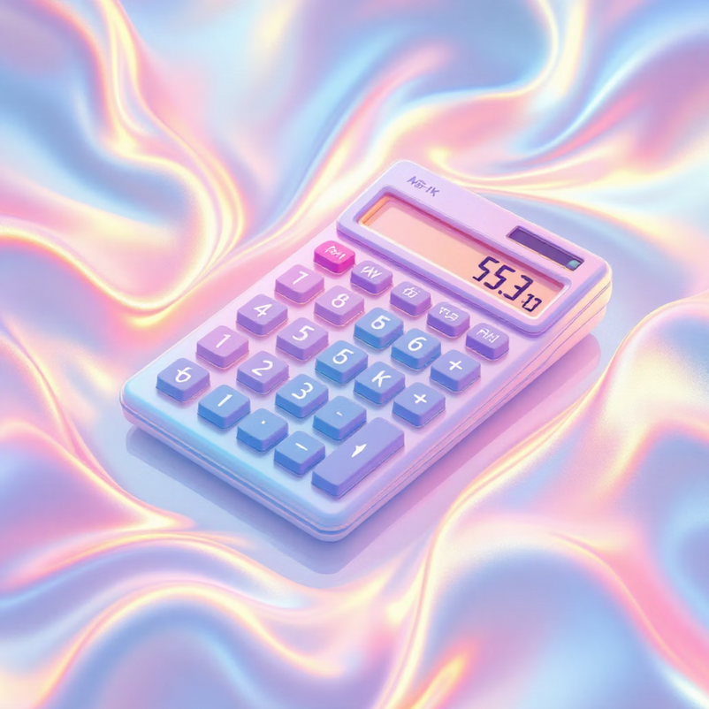
Scientific Notation & Significant Figures
Scientific Notation
Express large/small numbers as N × 10ⁿ where N is between 1-9.999...
  602,200,000,000,000,000,000,000 = 6.022 × 10²³
  0.00000000000000000000000166 = 1.66 × 10⁻²⁴
Significant Figures Rules
  All non-zero digits are significant
  Zeros between non-zeros are significant
  Leading zeros are not significant
  Trailing zeros after decimal are significant
Precision vs Accuracy: Precision is closeness of measurements to each other. Accuracy is agreement with true value.
Notes:
7

Slide 8
Laws of Chemical Combination
01
02
03
Conservation of Mass
Definite Proportions
Multiple Proportions
Matter cannot be created or destroyed in chemical reactions. Total mass remains constant.
Compounds always contain same elements in fixed mass ratios, regardless of source.
When elements form multiple compounds, mass ratios are simple whole numbers.
04
05
Gay Lussac's Law
Avogadro's Law
Gases combine in simple volume ratios at same temperature and pressure.
Equal volumes of gases contain equal numbers of molecules at same conditions.
Notes:
8

Slide 9




Atomic & Molecular Masses
Atomic Mass Unit (u)
Molecular Mass
Formula Mass
1 u = 1/12 mass of carbon-12 atom = 1.66056 × 10⁻²⁴ g. Standard for comparing atomic masses.
Sum of atomic masses in a molecule. Example: H₂O = 2(1.008) + 16.00 = 18.02 u
Used for ionic compounds without discrete molecules. Example: NaCl = 23.0 + 35.5 = 58.5 u
Notes:
9

Slide 10
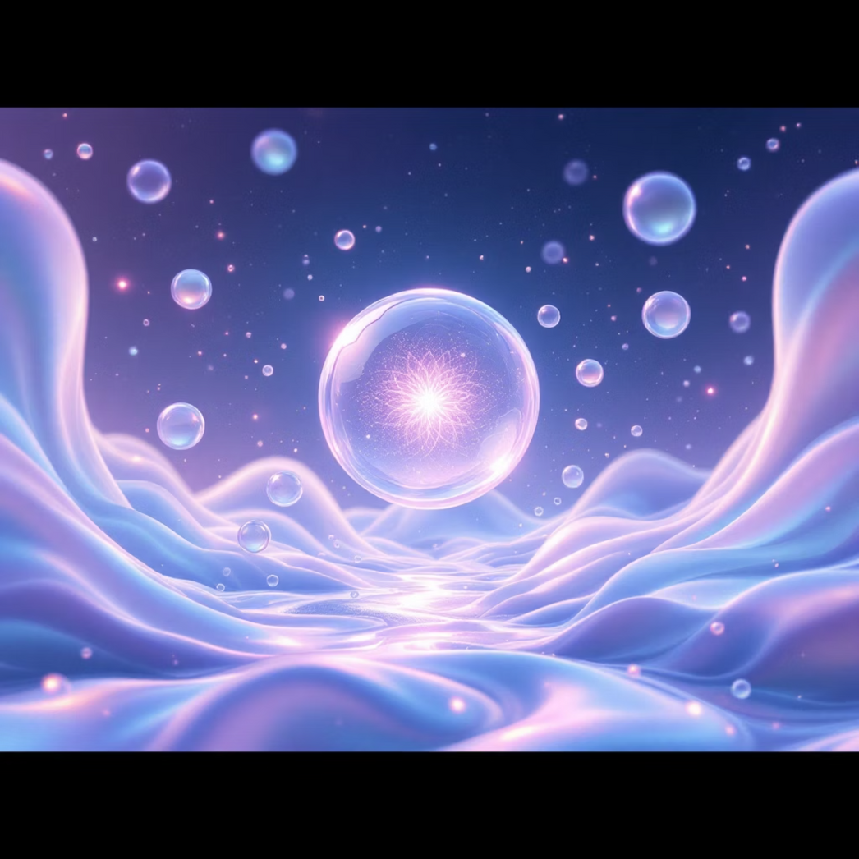
Mole Concept & Stoichiometry
6.022 × 10²³
Avogadro Number
One mole contains exactly 6.02214076 × 10²³ elementary entities (atoms, molecules, ions). This fundamental constant enables quantitative chemical calculations.
Key Applications:
  Converting between mass and moles
  Stoichiometric calculations
  Solution concentration (molarity, molality)
  Limiting reagent problems
Mole
Liters
= 6.022 × 10²³ particles
Gas volume at STP
Notes:
10

